Slide 1
Club Meetings and Membership
Katie Ramsey
Otero County 4-H Volunteer Leader

Slide 2
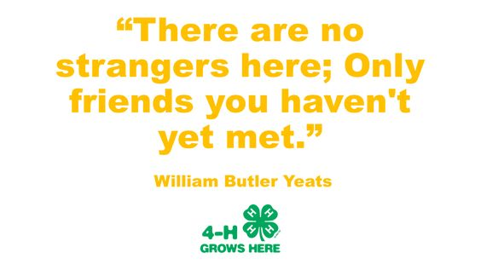
Place to Belong
Place for Everyone
Flexibility
Project Showcases
Officer Teams

Slide 3
Communication
Email
Consistency
Deadlines
Resources

Slide 4
Meetings Matters
Project Highlights
Guest Speakers
Fun
Service

Slide 5
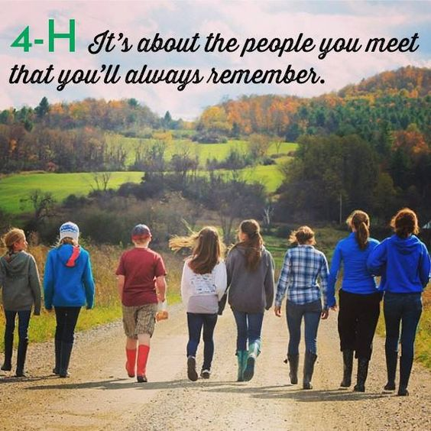
Questions?

